Slide 1
Applied Data Science
Exploratory Data Analysis
Group 4

Slide 2
Exploratory data analysis:
In statistics, exploratory data analysis is an approach of analyzing data sets to summarize their main characteristics, often using statistical graphics and other data visualization methods

Slide 3
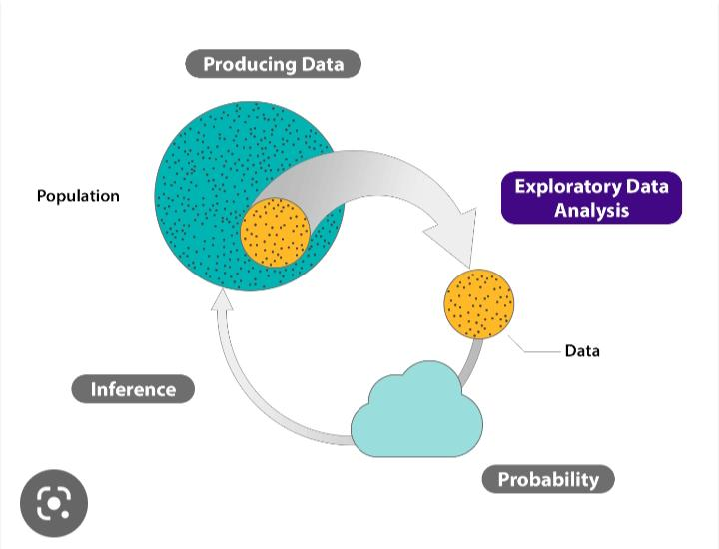

Slide 4
Importance:
The main purpose of EDA is to help look at data before making any assumptions.
It can help identify obvious errors, as well as better understand patterns within the data, detect outliers or anomalous events,
find interesting relations among the variables.

Slide 5
Strategy:
The exploratory data analysis steps that analysts have in mind when performing EDA include:
Asking the right questions related to the purpose of data analysis. Obtaining in-depth knowledge about problem domains. Setting clear objectives that are aligned with the desired outcomes.

Slide 6
Advantages:
Some advantages of Exploratory Data Analysis include:
Improve understanding of variables by extracting averages, mean, minimum, and maximum values, etc.
Discover errors , outliers, and missing values in the data.
Identify patterns by visualizing data in graphs such as box plots, scatter plots, and histograms.

